Slide 1
Innovative test solution
Provider
- Probe pin Datasheet -

Slide 2
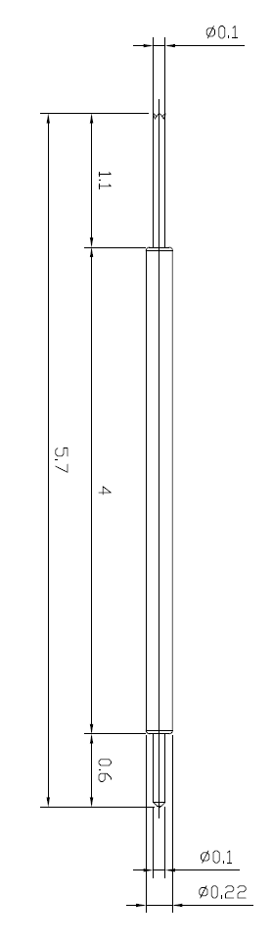
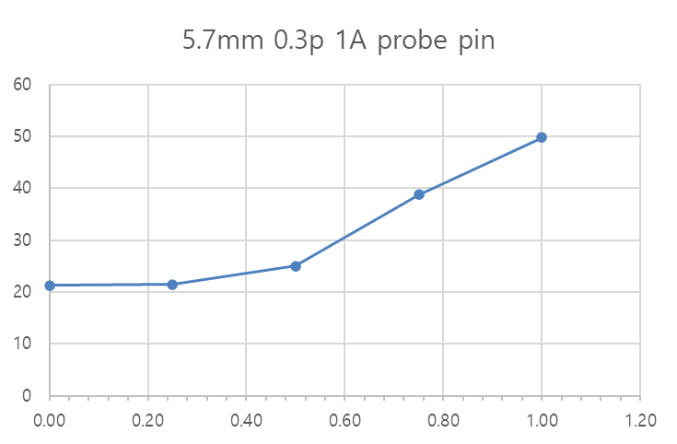
※ General POGO pin – 5.7mm / 0.3P
IVB-DCR-570-022-A222-00
5.7mm 0.3p
Current (A) | Temp. (T)
0.00 | 21.3
0.25 | 21.5
0.50 | 25
0.75 | 38.8
1.00 | 49.8
Temprature (°C)
Current (A)

